Slide 1
Building a Community of Practice for an Integrated Dementia Pathway

Slide 2
The process
Listening events
Two listening events were held, one at the commencement of the project, and one at the end
The first was to understand the challenges people faced
The second was to test out the new pathway that had been developed as a result of the feedback received
Building the community of practice
Practitioners from across the pathway came together to build the community of practice, working together and developing a common course of beliefs and understandings about how the system needed to evolve
Practitioners from across the community of practice supported the listening events by facilitating table discussions

Slide 3
Listening Event
What we heard
Invited people with lived experience (including families, friends and carers) to share stories
Gathered and shared peoples stories of lived experience
The event was well attended with good representation from across our communities

Slide 4
Developing the Community of Practice
Reviewed the feedback from the listening event
Started to review the pathway, looking at the opportunities, strengths and challenges
Reviewing areas of good and innovative practice
- Establishing where the community of practice first into the wider economy

Slide 5
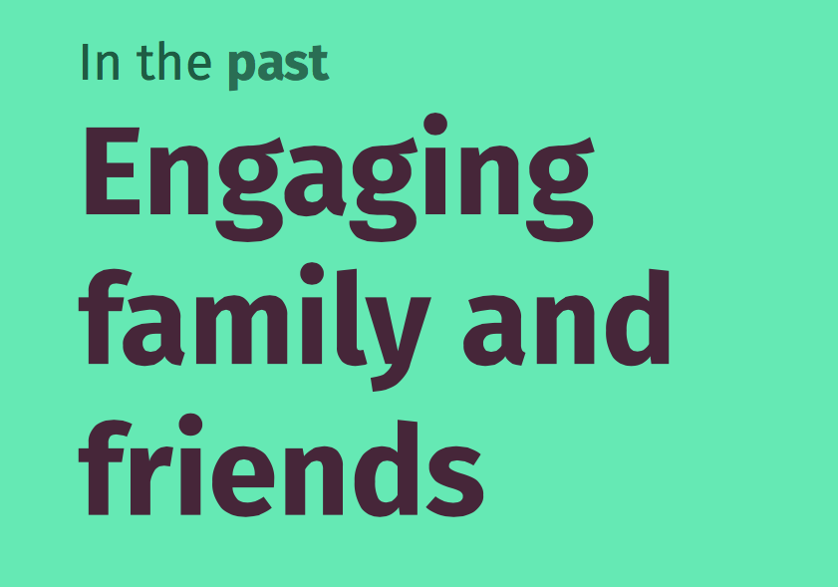
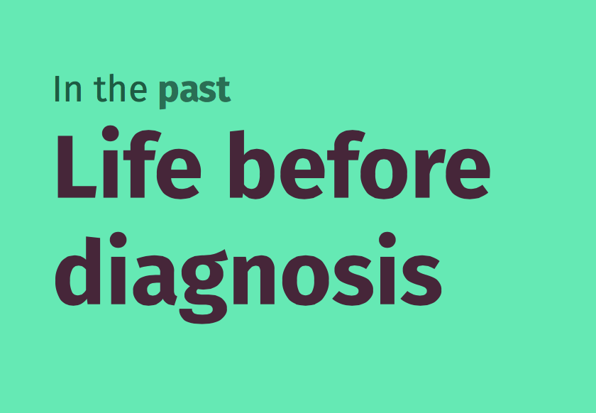
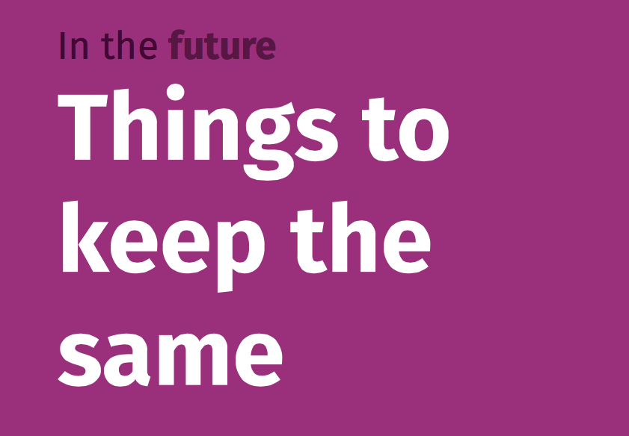
Developing the Priorities
Synthesising the learning
This was based on information that had been received during the listening event, and also work done outside the community of practice sessions
In addition, the community of practice members took time outside of the session to listen and capture life stories of people living with dementia, or supporting/caring for somebody who was living with dementia
.

Slide 6
The Priority Challenges
We must... be a system that listens and acts on what we hear
Establishing this as a core way of working
We must... have a workforce that is informed & educated about dementia
We must... communicate information in ways that work for people
Shaping services through information & education
We must... build on the skills and capabilities of people supporting others
We must...
connect and coordinate support activities across communities
We must... ensure we make resources truly accessible to people
Growing and building on the capacity of communities and peers

Slide 7
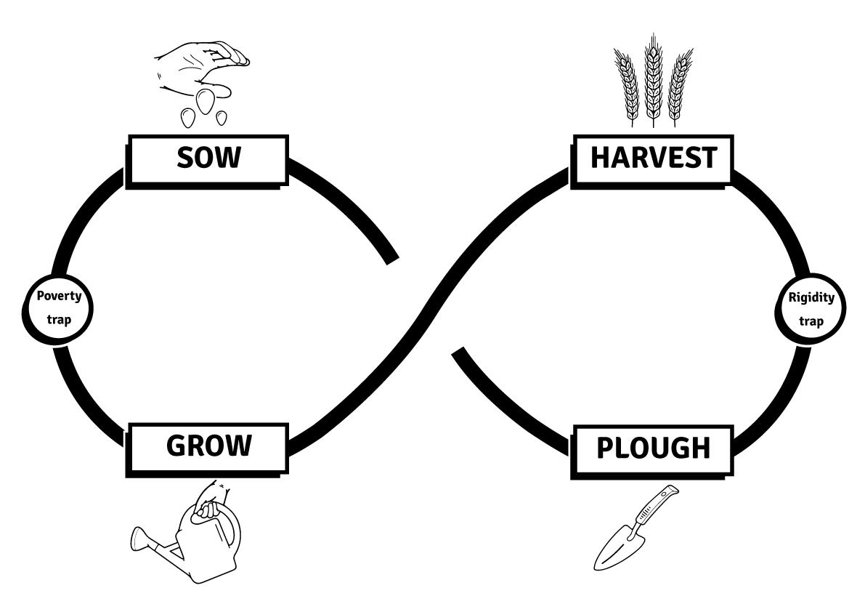
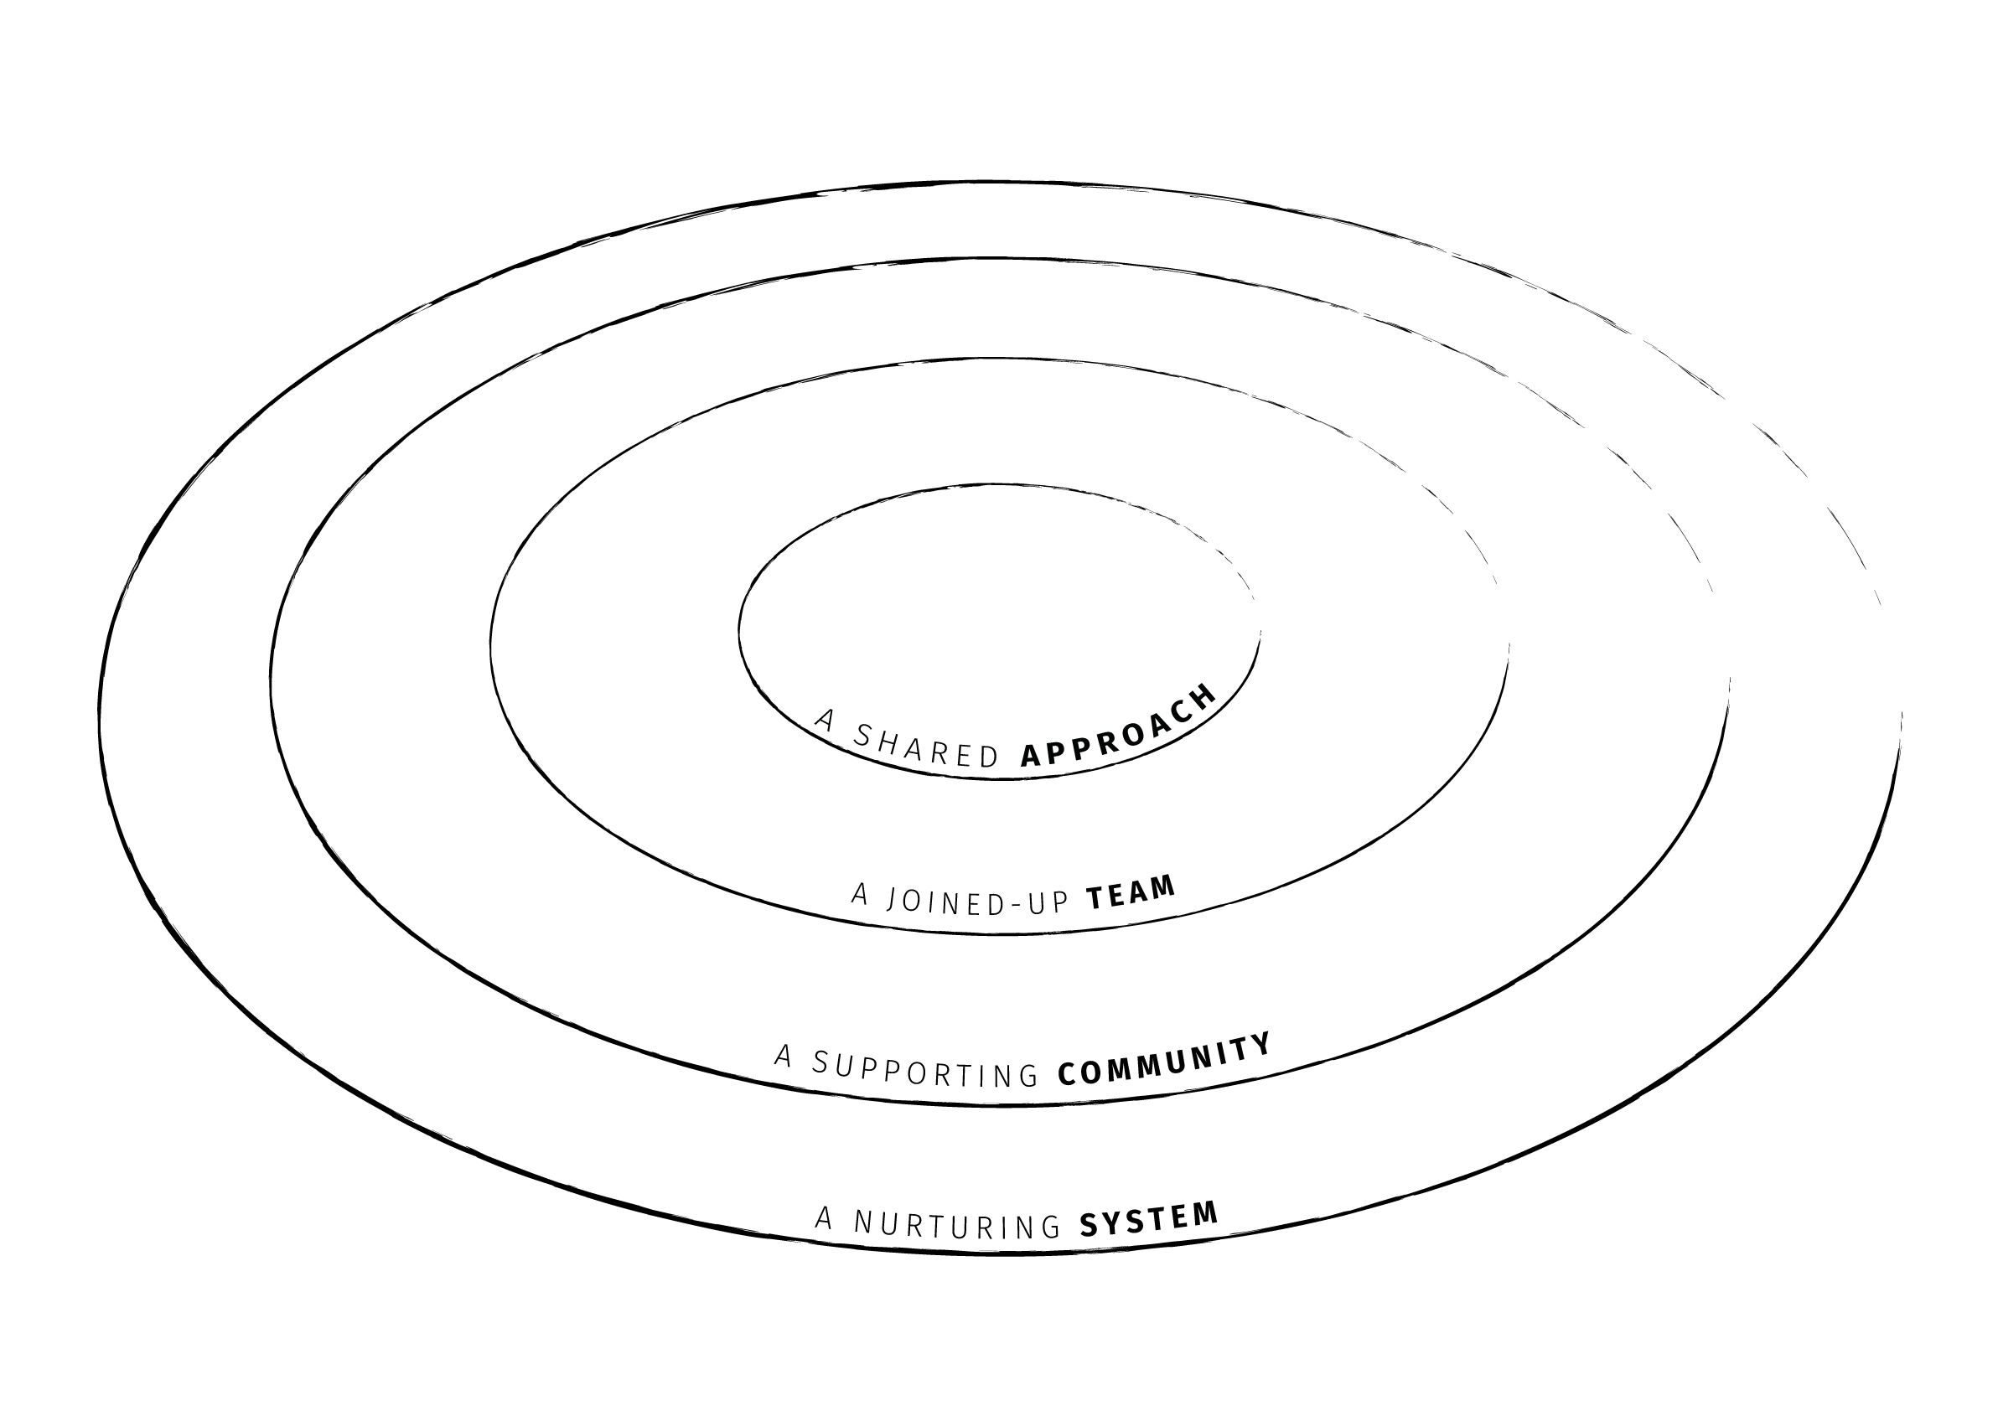
Sharing the Learning through an eco-systemic approach
Members of the group used the eco-system approach to continue to build the dementia pathway, continuing to draw on lived experiences of people they worked with, or who had engaged with the wider community of learning
A second clear principle from discussion was the requirement to adopt an approach that has:
A shared approach at it’s heart
A joined-up team that collaborates around a person
A supporting community that is inclusive and informed
A nurturing system that is educated and works to enhance

Slide 8
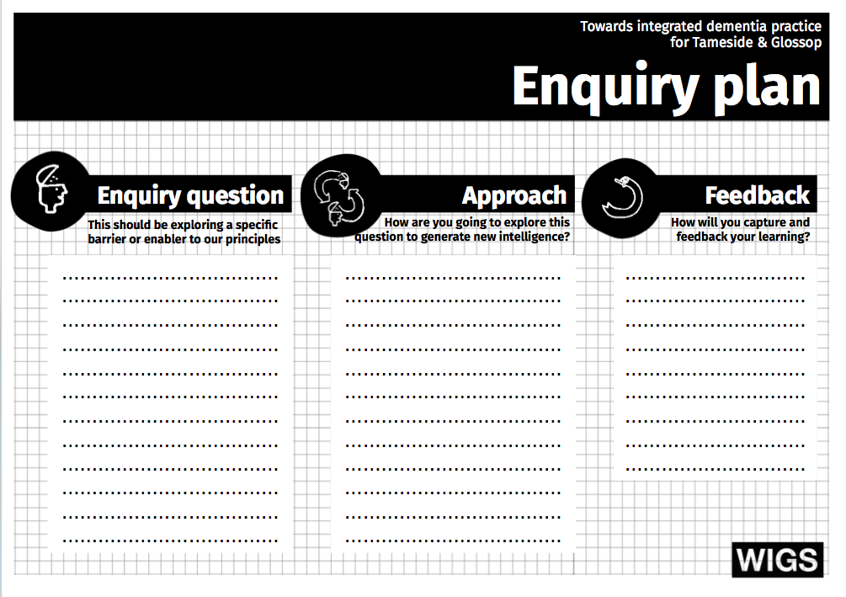
Proto-typing the new system
Prototyping | Piloting
Generative | Reductive
Agile | Fixed
Take managed risks | De-risks
Enables innovation | Restricts innovation
Co-producers | Guinea Pigs
versus
The approach was important, and a defined choice to adopt a proto-typing methodology was adopted to ensure that the person was at the centre of all developments
ONE priority Crux Element from the models
e.g.
Involving carers as equal partners

Slide 9
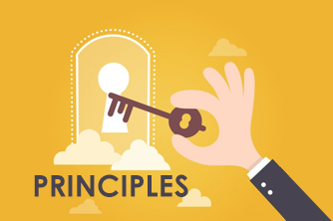
The Key Principles

Slide 10
We are always person-centred
We believe support is best when it places each individual’s needs and aspirations at the centre of how we assess, plan and support.
This means we value freedom of choice, tailoring what we do for each person and seeking to co-produce care with them and their carers or family where possible.

Slide 11
We are open for everyone
We are always seeking to be inclusive in the support we provide.
This means that we make things work to meet people’s lives, no matter where they live, their background or culture.

Slide 12
We have a shared approach
We believe that we should all have a shared approach to how we support people. This helps us work together better, collaborate with others and ensure people receive high quality support, no matter who from.

Slide 13
We build belonging
We know that relationships matter above all, yet people with dementia face stigma, exclusion and social isolation. In everything we do, we will always look to find ways to grow and sustain the positive supporting relationships people have.

Slide 14
We are in this together
We believe we are at our best when we work together.
Not just as professionals, but as a single dementia informed and friendly network of services, organisations, businesses, groups, carers & individuals across Tameside & Glossop.

Slide 15
We see knowledge as power
We know the power of raising awareness, informing & educating people about dementia. In everything we do, we look to help people to grow and be able to share an understanding of the impacts & challenges for people living with dementia & those caring for them.

Slide 16
We take the time to care
We know that some things take time, especially if we want people to experience care that feels personal and authentic. We make sure that we invest our time and energy in the things that are important to people living with dementia and those that care for them.

Slide 17
We maximise expertise
We know that great care & support requires different forms of expertise - from professional and clinical expertise, to that of lived experience.
We know we are at our best when we make the most of this expertise and ensure that we have diverse forms of expertise informing how we work and deliver support.

Slide 18
We listen, really listen
We know that there is great value in creating the time and space to deeply listen to people. It means truly valuing and trusting people’s personal insights of dementia and those of their carers, family & friends.

Slide 19
Progress since the inception of the community of practice
A further listening event took place where the developments of the programme were shared with all present, and received unanimous support
Tameside and Glossop now has a fully integrated post-diagnostic dementia pathway
The practitioners have owned the community of practice and continue to meet and develop the pathway on a regular basis

Slide 20
Next steps
The key principles need to form the core of the new Tameside and Glossop dementia strategy. While this is in progress as a co-produced element of work, covid-19 has interrupted the completion.
As systems develop they need to listen to those who use them. Ongoing feedback needs to be sought to refine areas of good practice and to eliminate any additional barriers encountered.

