Slide 1
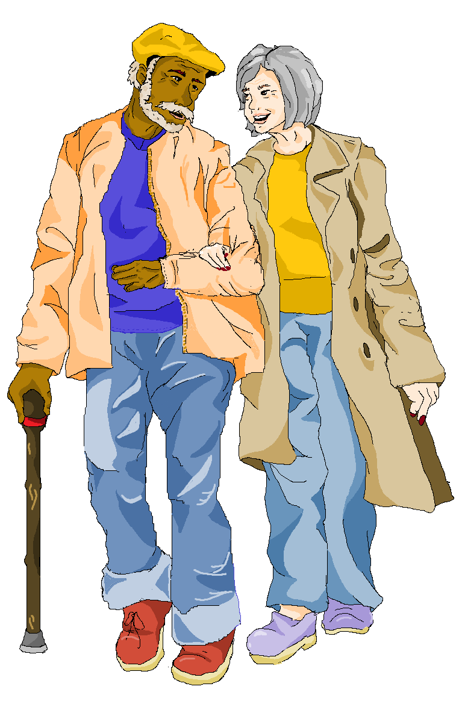
Greater Manchester’s Dementia Care Pathway September 2022 Presentation by: Helen Pratt, Sarah Fox, Cliff Wilson
The Greater Manchester integrated care partnership is helping organisations work better together with people and communities. We want people across all our boroughs to stay well, whatever their age, and whatever issues or conditions they might be managing. We’re bringing together all the different organisations that support people’s health and social care, so that services can join up and act faster when people need support.

Slide 2
We are Dementia United
Our aims and approach
A strength of this programme continues to be building networks and bringing partners/stakeholders together to work in collaboration. Another, is ensuring the voice of lived experience is a thread weaving all this work together.
We’re working towards improving the quality of life for people living with dementia or caring for someone who has dementia, supporting people to live as independently as possible and providing access to services when needed
Operations
Cross-cutting themes
Priority areas
Communication
Involvement (public, health/social care, voluntary)
Diversity, inclusion and inequalities
Data/ evaluation
Connecting services
Brain health/Wellbeing
Research
Education and training
Dementia United | GMHSC (dementia-united.org.uk)

Slide 3
History and development of the dementia care pathway
Paper format
Digital format
Greater Manchester Dementia United business case
Post Diagnostic Support Task and Finish group, wider engagement/co-production to develop a draft version
Feedback on Pathway standards from 10 localities and wider GM programmes
Dementia United programme identified Key Focus Areas - Post Diagnostic support
Feedback workshops in localities and survey with people affected by dementia
Commissioned Radical to develop a digital version
2017
2018
2019
2020
2021
2022

Slide 4
Developing the standards
Why did we do this?: Diagnosis and post diagnostic support varies across Greater Manchester and access to services is fragmented. Therefore, to address this issue we co-developed a set of standards which can be used to reduce variation in care and support across Greater Manchester.
Development:
Step 1: Dementia assurance report (contributors: locality leads, clinical teams, providers, lived experience) identified gaps and variations in care/support and made several recommendations.
Step 2: Over a 9 month period we used existing evidence and gap analysis via assurance report to brainstorm a list of standards. This work was co-produced with representation from localities, services and lived experience. This led to a list of over 100 standards
Step 3: These standards were then condensed to the 75 currently present in the pathway. This was achieved with input from over 130 people living with dementia, families and carers alongside health and social care staff, dementia locality leads and wider GM programs (e.g. Greater Sport)

Slide 5
Examples of how co-production has impacted the pathway
The following are some examples of changes to the pathway informed by our stakeholders:
Time to Diagnosis – the draft Dementia Care Pathway was ambiguous over the referral timeline, with two different deadlines for contacting the person living with dementia after referral. The longer deadline has been removed and the shorter deadline is now the requirement.
Carer – there was a strong emphasis on the needs of carers and the support they receive. The draft Dementia Care Pathway inadequately handled this aspect. A new structure for the whole pathway has been used which allows the needs of carers to be more easily seen and understood.
Staff Knowledge – the draft Dementia Care Pathway had no specific statements on the need for staff training in dementia. This has been corrected with a specific requirement for all staff who work with people living with dementia, but a recommendation for the type and level of training received.
Access to information regarding crisis services: Following several suggestions that information regarding crisis support should be prominent and easily accessible on our webpage we have added a crisis support tab to the top of the page

Slide 6
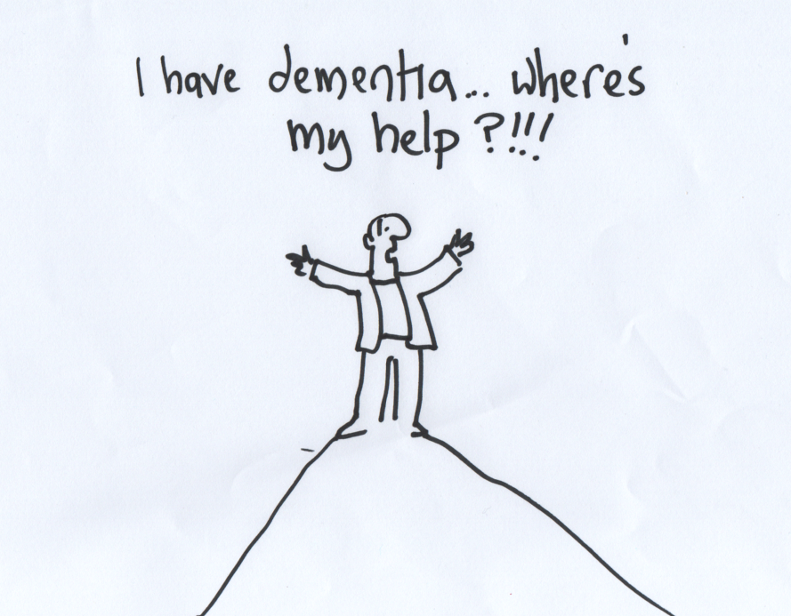
Goal of the pathway
Goal: To address support variation and fragmentation by bringing together a list of standards and recommended best practice. The pathway also provides information on how each locality is meeting these standards. It will help the health and social care system in Greater Manchester standardise the offer of care and support for people living with dementia and their carers, no matter where they live.
Quality standards are provided for all stages reflecting the NHS England Dementia Well pathway
Preventing well
Diagnosing well
Living well
Supporting
Dying well

Slide 7
The standards
The Pathway contains 75 standards drawn from existing services, national guidelines and the things people living with dementia and their care partners believe have a positive impact on their health, wellbeing and ability to live well with dementia.
Each standard has been given a priority status, these are:
Required to provide: These standards are requirements according to United Kingdom guidelines and all localities are required to provision for these.
Should be provided: Although United Kingdom guidelines do not list these recommendations as being a requirement, sufficient evidence exists to suggest that these recommendations should be provisioned.
Ambition: Emerging evidence suggests that these recommendations will benefit those living with dementia, their care partners or those at risk of developing dementia.
We do not expect localities to provision for every standard.
Though evidence, best practice and local, regional and national offers can be found for each standard which can be used to develop new services and improve existing provisions.

Slide 8
Each standard includes
Information:
Including standard and person-centred narrative – from the perspective of someone affected by dementia or a carer.
Regional, Local and national resources:
A selection of pre-existing resources (local, regional and national) which can be accessed to support patients (signposting) or to gain an understanding of pre-existing schemes and initiatives when commissioning new services
Evidence:
A list of evidence which supports selected standard
Best practice:
Examples of how the recommendation has previously been provisioned/actioned.
Examples of how the pathway can be used:

Slide 9
Example 1
Commissioning:
If you’re looking to commission a new service, you can find relevant evidence and examples in our pathway
Examples:
Service Mapping – All dementia services in your locality can be seen on the tool and gives commissioners a full picture of the provision in their locality .
Strategy Development – The standards have been developed from engaging with people with lived experience from al 10 localities. This can be used as a reference for strategy development.
Identifying Best Practice - The tool has the benefit of enabling the user to look at the local service offer in any of the Greater Manchester localities. The Commissioner can view the offer in other localities and learn from them
Supporting Local Services - Commissioners should be encouraging local dementia services to actively use the tool to identify services in the area that are relevant to the patient and give guidance on how to use it.
Cross Border Working - Now we are an ICB, work will be developed that may cross borders and the tool will help the user find available services in localities they may not be familiar with

Slide 10
Example 2
Signposting:
If you’re supporting someone affected by dementia or a carer you can use the pathway to find what services and support are available in your local area which your service users can then access.
Scenario: You’re a dementia advisor meeting with a person living with dementia. They say that they are interested in joining an arts group to stay social and meet new people
To find what local services are available you will;
Access the Pathway website: https://www.gmdementiaresources.org.uk/
Navigate to your locality
Search for a related term i.e. ‘arts’ and select the most appropriate standard
You can print this information for your patient, highlighting/circling services they may want to access
Let’s try this

Slide 11
Example 3
Best Practice:
If you’re looking to improve your service or add a new service you can use information from the pathway to guide your work.
Scenario: You are a GP and you are auditing your health check protocol. You want to add dementia screening to this process.
To find resources and best practice:
Navigate to the pathway home page: https://www.gmdementiaresources.org.uk/
Type ‘health check’ into the search bar
Select the most appropriate standard
Here you will see resources, evidence and best practice to help you do this
Let’s try this

Slide 12
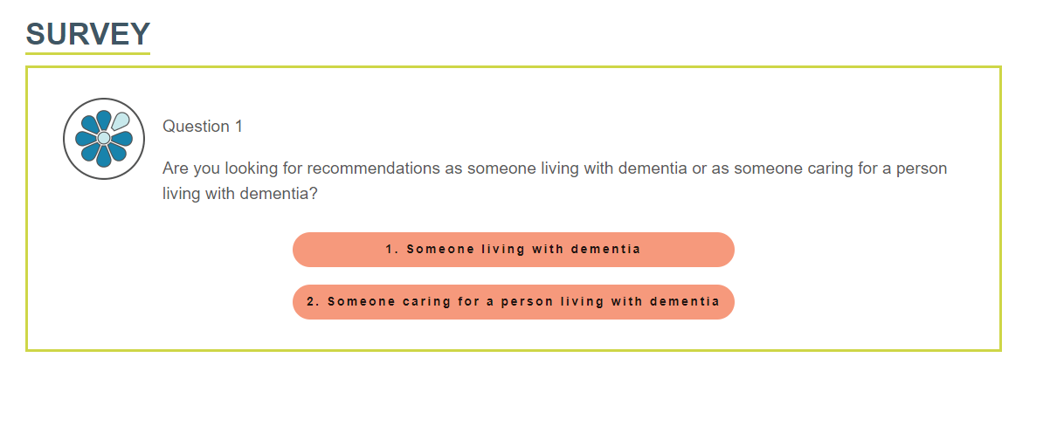
Using our questionnaire
If you are living with dementia or caring for someone living with dementia and wish to view all recommendations relevant to you and your experience you can use our survey. This can be accessed via the link below
https://www.gmdementiaresources.org.uk/survey

Slide 13
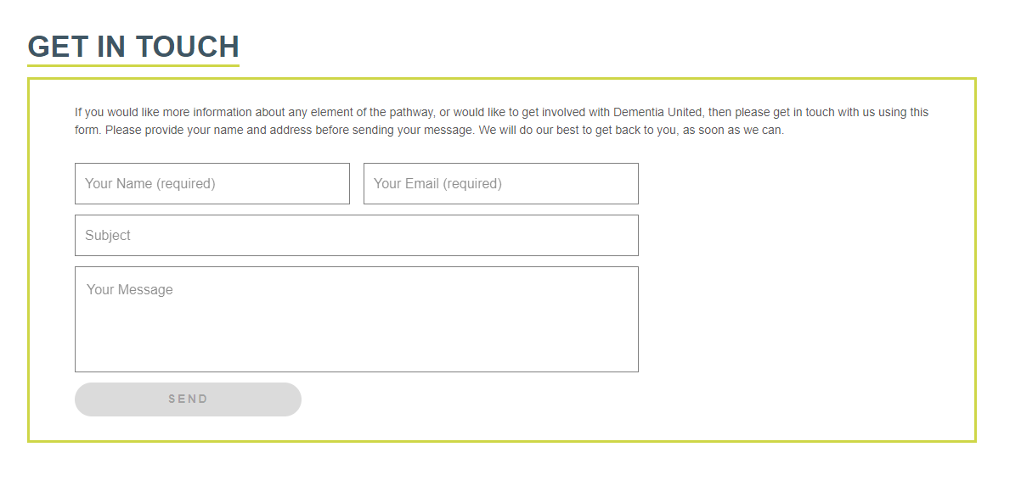
How to contact us
https://www.gmdementiaresources.org.uk/get-in-touch

Slide 14
Now it’s your turn
Take 10 minutes to explore the website yourself and ask us any questions
Your tasks:
You are speaking with a service user who wants to join a leisure activity in Bolton, find what groups are available.
You’re speaking with a carer who wants to know their rights as a carer when visiting their loved one in hospital, can you download this information to hand to the carer?
You’re asked about how the pathway is updated and how often this happens, can you find this information?
https://www.gmdementiaresources.org.uk/
Notes:
Pause the recording here. Allow your delegates to have 10 mins to use the Pathway and search. Re-start the recording once everyone is back from having a go.

Slide 15
Our ask of you – please promote and use the Pathway in your work areas/teams We have provided materials that you can be printing off and handing out

Slide 16
How to contact us in Dementia United
Thank you If you are interested in finding out more get in touch
Email: gmhscp.dementiaunited@nhs.net

