Slide 1

Welcome
Many thanks for joining Greater Manchester’s best practice Delirium webinar on 14th October 2022
We will start shortly – and will be recording the session in order to share this, the slides from today and delirium resources
Please put your email/role and name in the chat so we can share the resources with you
Please remain on mute during the presentations
The Greater Manchester integrated care partnership is helping organisations work better together with people and communities. We want people across all our boroughs to stay well, whatever their age, and whatever issues or conditions they might be managing. We’re bringing together all the different organisations that support people’s health and social care, so that services can join up and act faster when people need support.

Slide 2
Agenda
Topic | Speaker
What is delirium, why it is so important to detect and treat | Emma Vardy
Introduction to Dementia United’s Greater Manchester Delirium programme | Helen Pratt
Best practice examples from across Greater Manchester
Stockport’s implementation of the Community Delirium pathway and toolkit | Jayne Etches
Accuracy of the 4AT in non-English speaking patients | Anham Ahmad
Harnessing lived experience; lessons learned from the co-production of a delirium zine | Jacqueline Widdowson & Helen Pratt
Q&A with all speakers
Comfort break – 5 mins
7 minute education sessions in the hospital - an example from Trafford Hospital | Sam Turner
News2 alongside the 4AT – lessons learned | Emma Vardy
Pre-operative planning for the risk of delirium – an example from Tameside Hospital | Kellie Smart
Q&A with all speakers
Evaluation and thank you | Emma Vardy

Slide 3
What is delirium?
What is delirium?
Delirium causes a short term confused state, that develops over hours or days.
Delirium is a disturbance in someone’s attention, awareness, disturbance in cognition (poor memory, disorientation, difficulty with speech/writing). People may also experience changes in behaviour (which may include experiencing hallucinations, paranoid ideation) and emotional disturbance (people may experience sudden onset low mood, anxiety, irritability, apathy, distress)
Delirium classification; Hyperactive (restlessness, agitation, non-purposeful walking, insomnia, rapid mood changes) Hypoactive (drowsiness, withdrawn, reduced motor activity); people with hypoactive delirium often look like they are dying, but may recover.
Often the person fluctuates between hyperactive and hypoactive states over the day/or days.
Most delirium has a duration of a small number of days, but in around 20% of cases, it can persist for weeks SIGN157
Notes:
The disturbances cannot be better explained by another pre-existing, evolving or established neurocognitive disorder, and do not occur in the context of a severely reduced level of arousal, such as coma.
(DSM V)

Slide 4
Why is it so important to detect and treat delirium?
Delirium is independently linked with poor outcomes including medical complications, increased length of hospital stay (2-3 fold), new institutionalisation SIGN157 as well as admission and readmission to hospital
Delirium is persistently associated with nearly a three-fold increase in one-year mortality, independent of age, gender, morbidity, functional status and dementia
Multiple long term consequences for the patient who experiences delirium and these impact on distress for family members too
Increased risk of malnutrition, falls (2 fold), problems with functioning
Increased risk of deteriorating cognition where someone has a dementia diagnosis
Increased risk of experiencing delirium again
Increased risk of developing dementia
Increased trauma and distress following an episode of delirium
30% of delirium is preventable
Incidence of delirium 1 in 8 acute hospital inpatients, up to 36% in care homes particularly in older/frailer residents, up to 40% in palliative care units

Slide 5

Dementia United is NHS Greater Manchester’s Integrated Care programme for dementia
We work alongside clinicians, charities, localities, professionals, those living with dementia, families, friends and care partners to make our region the best place to live if you have or are caring for someone with dementia.
The link here to the Dementia United programme Dementia United | GMHSC (dementia-united.org.uk)
Helen Pratt, Project Manager, Dementia United
Email: gmhscp.dementiaunited@nhs.net
Cartoon by Tony Husband

Slide 6

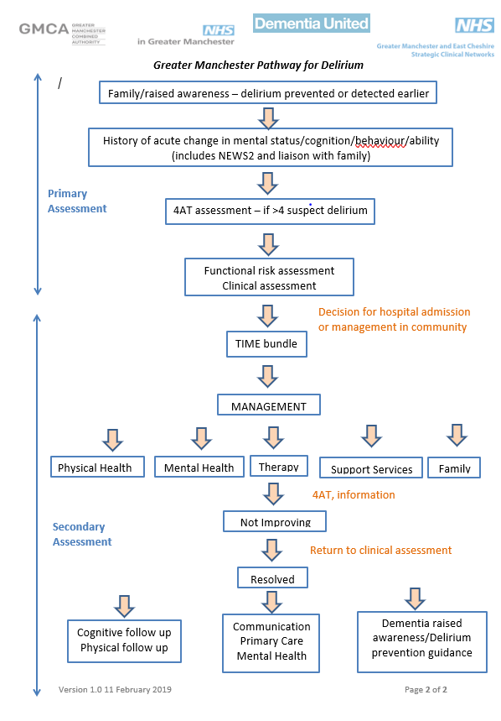
Greater Manchester Delirium Pathway and programme
Building on a community of practice
Harness engagement in what ever form; mental health, care homes, care providers, allied health professionals, acute care, primary care, voluntary sector, dementia advisors, ambulance services, pharmacy, commissioners
Lived experience engagement at an early stage
Free World Delirium Awareness Day Events 2018, 2019, 2020
Delirium programme focusing on: Prevention, early detection, systematic standardised approach to assessment, establishing causes of delirium and management
Our goals in developing Toolkits for health and social care staff
Safe management in own home/care setting
Reduce unnecessary hospital admissions
Improve prognosis
Enable the early detection, standardised approach

Slide 7
Pilot of the GM Community Toolkit in 2020 (fast tracked due to Covid-19)
Pilot goals
To understand if the community delirium toolkit could be implemented
To identify what resources are needed to implement
To consider whether the toolkit is likely to deliver the intended benefits/aims
Who took part in the Pilot?
5 localities Bolton, Manchester, Salford, Stockport and Trafford
Mostly with urgent care teams, as well as in 1 PCN and intermediate care
Pilot results
GM Primary Care Board - supported roll out of the Community Delirium Toolkit across Greater Manchester
70% of people were safely managed at home
Families reported very positively on the value of the delirium leaflet and early assessment and support
Academic publication about the Pilot Delirium can be safely managed in the community through implementation of a community toolkit: a proof-of-concept pilot study | RCP Journals
University of Manchester - undertaking qualitative evaluation with the staff from the Pilot teams
Notes:
Helen to do over view of the Pilot

Slide 8

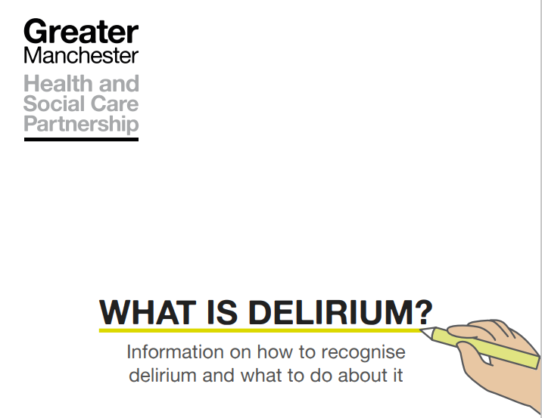

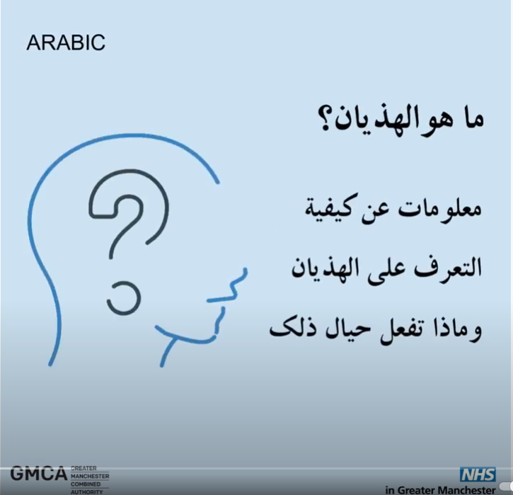
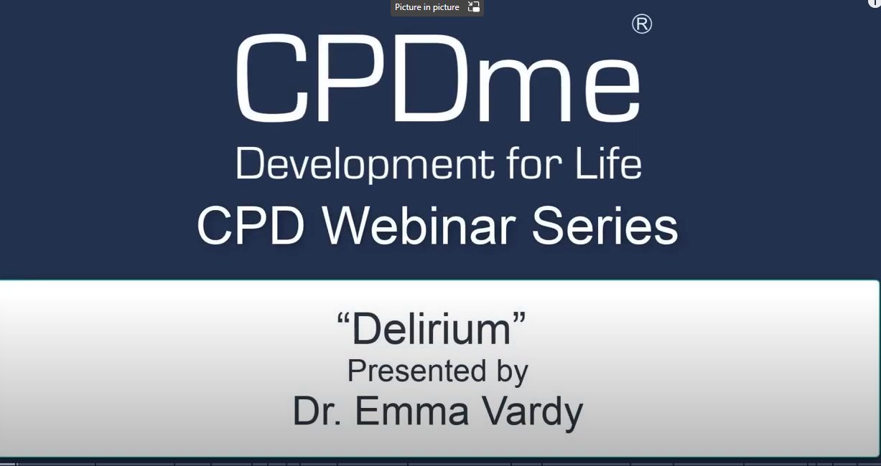
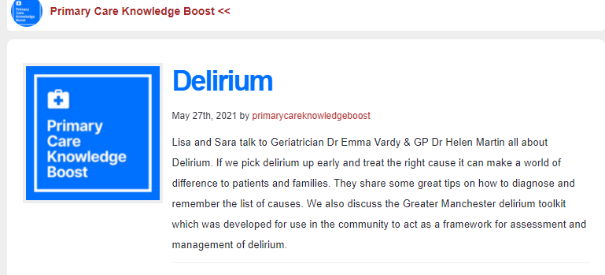

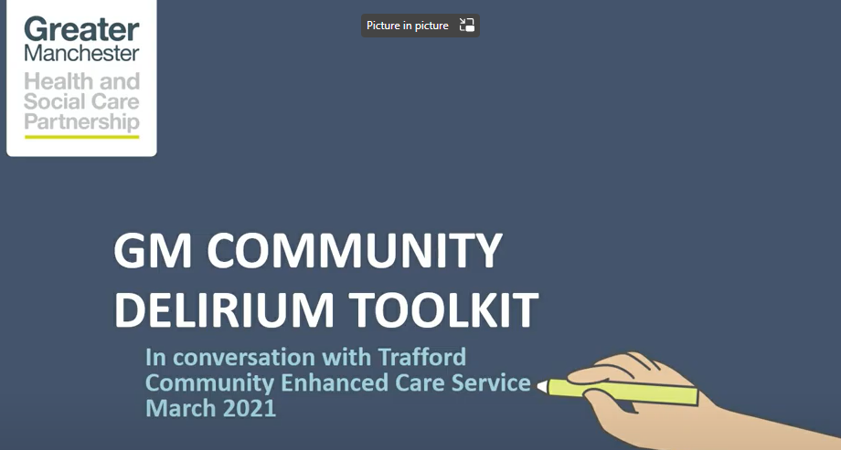
GM’s co-produced resources
Greater-Manchester-delirium-Leaflet-long-version.pdf (dementia-united.org.uk)
Greater Manchester Community Delirium Toolkit - Dementia United (dementia-united.org.uk)
Greater Manchester Hospital Delirium Toolkit - Dementia United (dementia-united.org.uk)
Translated delirium resources - Dementia United (dementia-united.org.uk)
Greater-Manchester-Community-Delirium-Toolkit-Pilot-Report-March-2021-1.pdf (dementia-united.org.uk)
Training resources Delirium toolkit training resources - Dementia United (dementia-united.org.uk) including from across UK
(82) Delirium Presented By Dr Emma Vardy - YouTube
In conversation with community colleagues - Dementia United (dementia-united.org.uk)
Delirium (pckb.org)
Notes:
Co-production at the heart of the delirium programme

Slide 9
Ripple effect of GM delirium programme
International: European Delirium Association
National: London, Devon, South Tyneside, South East England, Suffolk, Gloucestershire, Newcastle, British Geriatric Society, Royal College of Emergency Medicine study day, National Dementia Network webinar , NICE case study
Pilot in 5 boroughs community toolkit
GM: 10 boroughs locality led adoption with Health Innovation Manchester, GM Out of Hours alliance, GM Hospital Delirium group, GM libraries Zine workshop harnessing creative voices of lived experience
North West: NW Ambulance Service, Warrington, East Cheshire, CMHT Wirral, Derbyshire, NW ADASS care homes quality series

Slide 10
Three best practice examples from across Greater Manchester
1. Stockport’s implementation of the Community Delirium pathway and toolkit | Jayne Etches
2. Non English speaking – application of the 4AT Delirium screening tool | Anham Ahmad
3. Developing a delirium zine; harnessing lived experience | Jacqueline Widdowson & Helen Pratt
Q&A with all speakers
Comfort break 5 mins

Slide 11


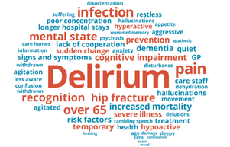


Stockport Community Delirium Pathway
A person - centred approach to early detection, rapid assessment and successful treatment of delirium in the community
Notes:
A hospital admission with delirium is associated with poor symptom control, deconditioning, an increased risk of long-term care and even death.
The aim of this Pathway is to reduce unnecessary hosp admissions and improve outcomes for those affected by delirium.

Slide 12
WHAT HAVE WE DONE
Aim
proactively identify delirium
(deteriorating patient)
+
provide a rapid clinical assessment
+
devise a treatment plan with patient/carers
=
remain safe at home
Delirium Pathway
Training for all staff
Developed Pathway
Pilot with Victoria DN Team
(with GM Dementia United)
Gathered data, evaluated project and shared learning
Roll out/ Spread
Staff and patient experience
Notes:
The AIM of the pathway - proactively ID delirium, provide a 2 hr rapid clinical assessment, and devise a treatment plan with patient/carers, to safely support admission avoidance.
What we have done….using a train the trainer approach training was provided to community, staff who are in a position to detect delirium so GP’s DN’s ACP, Specialist services, unregistered staff were included too.
In the initial pilot with Victoria PCN, (population of 46,000 ) all the pts avoided admission. We spoke to patients, and carers and staff who have referred to CRT, in order to review the process and in collaboration with GM Dementia Utd we have shared our learning across GM.
We launched the pathway in June 2022.

Slide 13
The Pathway
Primary Assessment - Patients, suspected of delirium, receive an assessment in their own home:
  NEWS 2
  Urgent bloods
  Delirium screening tool 4AT used
Rapid Clinical Assessment – carried out by CRT 98.9 % of assessments within 2 hours!
  Establish cause of delirium (PINCHME)
  Review of bloods
  Functional risk assessment
Co-produced Community Management Plan - The CRT assessor will treat the cause of the delirium and devise a management and escalation plan with patients and carers
  Treatment
  Clinical Observations and ongoing review
  MDT approach
  Mental Health Liaison
  Onward referrals
Outcomes
  Patient remains at home
  Patient places in step up bed (ringfenced)
  Ambulance if required
Notes:
1.Primary assessment is carried out by, ie DN’s, specialist services, Macmillan nurses, Paramedics and GP’s,
2. if delirium is detected, CRT carry out a rapid clinical assessment within 2 hrs to determine the cause
3. a management plan with an MDT approach, is devised with the pt and carers and will include; clinical and therapy and ASC intervention, and also incorporate SSW support.

Slide 14

What’s changed
What happened before
Ambulance called for 100% Patients
100% of patient attended ED
In 21/ 22
98.1% patients with delirium admitted
Pre Delirium Pathway
Primary Assessment (minus delirium screen)
Ambulance
ED
Admitted
Primary Care
Ambulance
Community Nurse
Mental Health
Doctor
Nurse
ANP/ACP
Therapist
NWAS
Crisis Response Team (MDT)
ANP
Nurse
Therapist
Social Worker
Support Worker
Primary Care
Ambulance
Community Nurse
Mental Health
Co-Produced
Crisis Response Team (MDT)
Patient & Carer
Primary Assessment
Rapid Clinical Assessment
Community Management Plan
Outcomes
With Delirium Pathway
Within 72 hours
What happens
now
Within 2 hours
Immediate treatment & support
88% patients remain safely their own home!!
Notes:
PRE pathway if deterioration was due to a potential delirium, when questioned, staff stated their only option was hosp attendance , 2021/22 data indicates that 98.1% of pts in Stockport who presented with Delirium were admitted
In the first 3 weeks of the pathway launch 14/16 pts experiencing delirium avoided admission = 88% of patients remained safely at home
Improved patient and carers experience
Prevention of hospital attendance and admission and associated costs

Slide 15
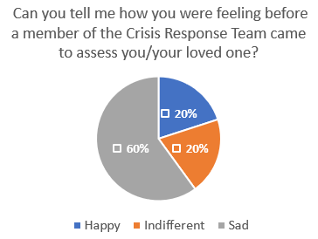
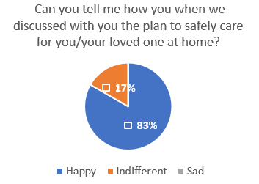
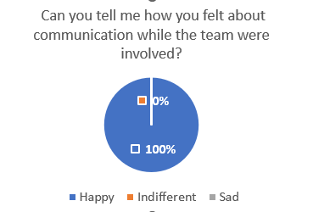
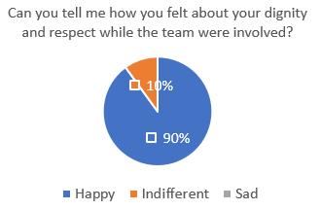
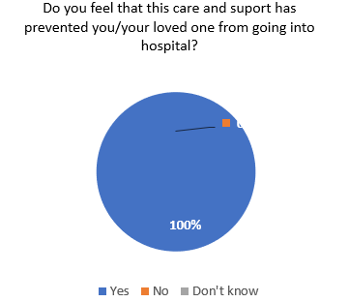
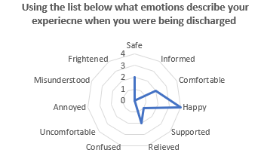
Feedback from Patient and Carers
The experience of patients and their loved ones is at the heart of what we do
60% of patients were sad before the CRT came to assess them
83% of patients were happy when with a plan to keep them at home
100% of patients were happy with Communication
Patient Experience Questionnaires were co-designed with Patients and Carers
90% of patients were happy their dignity and respect was well managed by the team
100% of patients said the support avoided hospital
All patients felt positive emotions about avoiding a hospital admission
Notes:
being cared for at home is a richer experience
60% felt sad before the home assessment and with our intervention, feelings changed to happy and informed and relieved. 100% of pts stated this support avoided hospital admission.
Be good to have short patient video and also Jayne outlining pathway etc

Slide 16
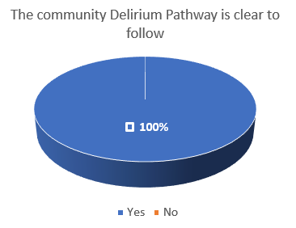
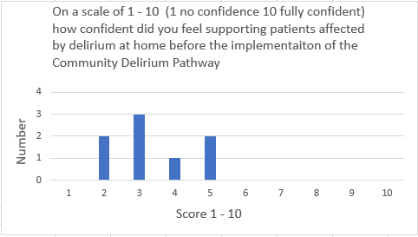
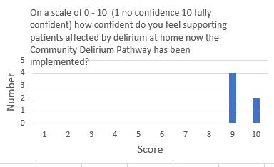
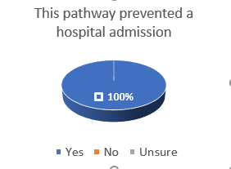
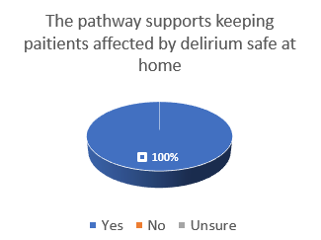
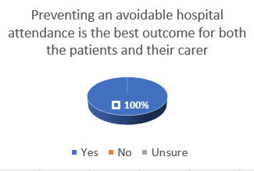
Feedback from Staff Using Pathway
100% of staff said that the pathway is clear to use
100& of staff using said using the pathway increased their confidence in manging patients with delirium in their own homes significantly
Confidence before pathway
Confidence with pathway
100% of staff said preventing hospital admission is the best outcome for patients with delirium and their carers
100% of referrers said that the pathway prevented a hospital admission
100% of staff said that the pathway supports keeping patients safely at home
Notes:
The feedback from staff was also positive,
100% of staff stated patients were maintained safely in their own home and admissions were avoided which for people affected by delirium, is the best outcome
Significantly staff stated the pathway increased their confidence in managing delirium at home

Slide 17

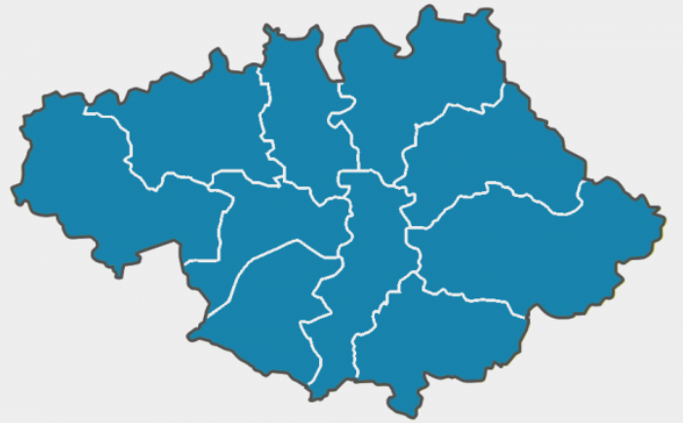


SPREAD
August 20 - March 21
March 21 –
Dec 22
From
March 21
From
June 22
PCN
Level
Stockport Level
Informing
GM Practice
Influencing
National Guidance
and Practice
Pilot with Stockport Neighbourhood Team
Full roll out across the Stockport Borough
Shared Pathway and learning with colleagues in GM & Dementia United
GM Roll Out
Honorary Role with NICE,
reviewing delirium standards & Informing guidelines
Easy to spread – cost neutral implementation
Notes:
KAY
There has been a ripple effect
Easy to spread – it is a cost neutral implementation, no new equipment required, no new IT systems, no time-consuming training programmes. The pathway is about using our existing knowledge and skill set differently
PCN- Stockport-shared with GM and is currently working aa part of the NICE programme to both benchmark against best practice and influence National thinking and strategy

Slide 18
What Patients and Staff Said
Patient
There was a plan in place to and I’m very happy!
D2A Nurse
The pathway is good for patients and carers as there is less risk of further infections and patients are more settled because they are in their own home
DN Team Lead
This is emotionally better as patients recover better at home in their own surroundings
Patient
I was relieved I didn’t need to go to hospital
D2A Nurse
Patients with delirium should remain in their own homes as this wis a familiar place
Patient
I feel valued
Thanks Guys!
Patient
everyone was very lovely and caring, thank you
Patient
I was relieved to stay at home
Patient
I was happy and supported.
Thank you for everything
Apprentice DN
The pathway has a positive impact as it is a clear pathway for clinicians to follow which increases the standard of patients care & safety at home
District Nurse
Patients are safer in their own home, and usually recover sooner
Notes:
the purpose of this slide is to illustrate the lived experience of delirium when the Pathway is implemented.

Slide 19

Jayne Etches
CRT Service Lead
RN, District Nurse, BSc (Hons)
NICE Committee Member (Delirium)
Jayne.etches@stockport.nhs.uk
07810 816214

Slide 20
Accuracy of the 4AT in non-English speaking patients
ANHAM AHMAD
DR EMMA VARDY

Slide 21
Aims
1. Accuracy of 4AT 4AT (dementia-united.org.uk) test in patients who do not speak English
2. Use of translators during 4AT assessments

Slide 22
Non-English Speaking patients
A significant number of patients do not speak English as first language
Subjective nature
Language barriers
Gap in literature

Slide 23
Methodology
Retrospective study
All non-English speaking patients, aged over 65 who attended A&E at Salford Royal Hospital from 2/11/21 until 27/4/22
76 patients
Admission documents were utilised to find details of 4AT
Spreadsheet created: age, admission reason, 4AT score, language spoken, use of interpreter

Slide 24
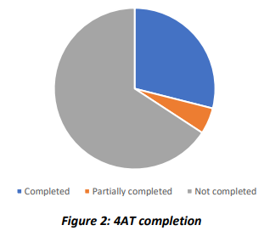
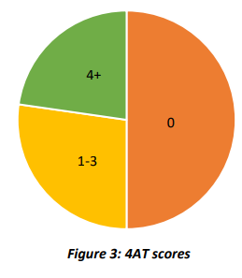
Results
16 different languages: Urdu, Polish, Arabic
Only 22 patients had 4AT completed on admission compared to 42% of all patients aged 65 and over
A variety of scores, 50% scored 0

Slide 25
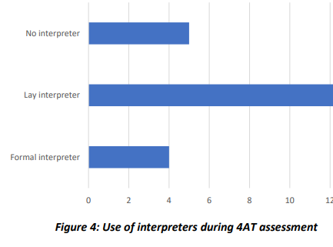
Results continued
Of the 22 patients who had 4AT completed: 5 had no interpreter
Of the 17 who had interpreters, only 4 were formal interpreters

Slide 26
Conclusion and recommendations
Low rate of 4AT completion
Increase awareness of completing 4AT assessment such as posters
Interpreters were not used in majority of cases
Consider translating 4AT into further languages
Ensure interpreters are present

Slide 27
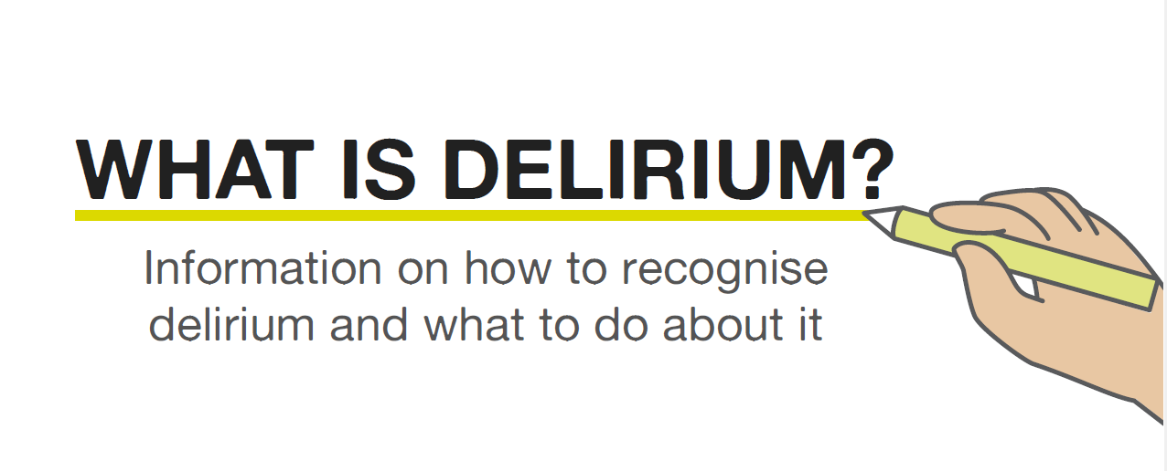
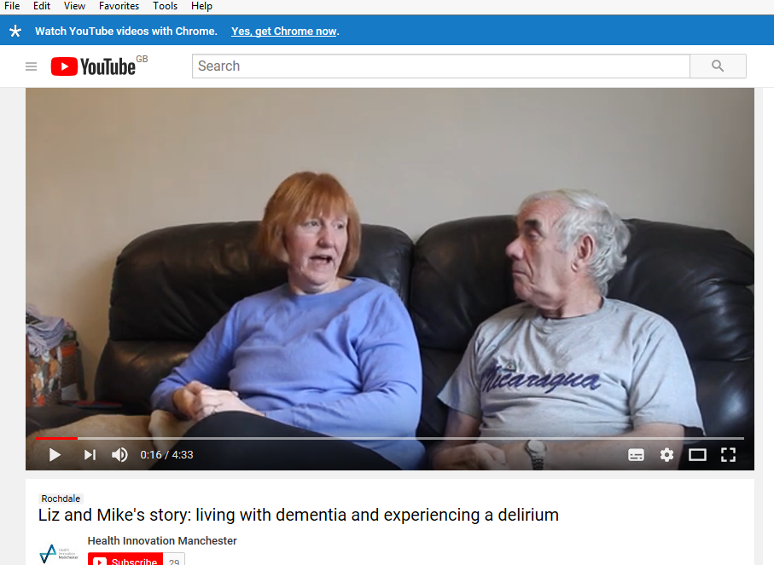
Harnessing lived experience and co-production at the heart of Dementia United’s work; creating a Delirium Zine
Translated delirium resources - Dementia United (dementia-united.org.uk)
Delirium toolkit training resources - Dementia United (dementia-united.org.uk)
Lived experience engagement people with dementia, Dementia Carers Expert Reference Group, South Asian Carers group and Greater Manchester’s Older People’s Network (Health and Social Care group)
Lived experience accounts
John’s account of his hospital experience, Liz and Mike film Delirium - Dementia United (dementia-united.org.uk)

Slide 28
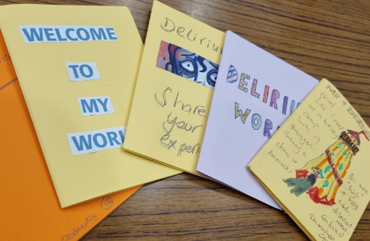
What is a Zine?
Zines give voice to the disenfranchised
Self-published
Mixed-media format to suit all abilities and inclinations
Compact 8-page print makes for easy circulation and reproducibility
The medium of social activism
It is the publication format for people who have something to say

Slide 29
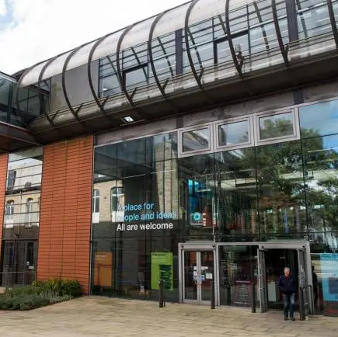
Why Oldham Libraries?
Oldham Libraries active participants in the GM Dementia working groups
safe, warm, welcoming spaces
that promote cultural engagement
Universal Health Offer
Programme of activity to support health and wellbeing

Slide 30
A Delirium Zine Workshop
Art materials, including magazines, coloured papers and newspapers for use in collaging
Professional facilitator - to support creativity
Refreshments provided – for comfort and relaxation
13-page prompt booklet that gave participants a starting point for each page in their booklet. Including:
  Thought provoking questions
  book extracts,
  recordings of first-hand accounts
  artists impetrations of the experience of Delirium.
Transport provided to enable all interested parties to attend.
CC Licenced the Zines (and gained photographic consent)

Slide 31
Some Key Findings/Learning/Outcomes
Participants reported feelings of surprise, concerning how much they were able to get from the experience – finding voice, where they had not before
100% of attendees said they felt ‘able to participate’
There was real value in including HCPs and family, as well as patients in the workshop – a whole systems approach to representing this experience and supporting wider wellbeing
Engagement through networking – take the offer to spaces inhabited by the target audience
The resultant Zines are being curated into a Delirium Awareness Zines eBook – due to be released on the GM libraries eBook platform: Borrowbox

Slide 32
What Participants Told Us:
“It was fun and very therapeutic”
“Enables revisioning of an experience”
“It was a very effective way of representing our experiences”
“I took away a sense of wellbeing”
“I felt that I am not alone on my journey of delirium”
“Zines have the power to get people talking”
“Delirium leaves a mark that needs to be talked about”

Slide 33
Welcome back from the comfort break
Best practice examples from across Greater Manchester
7 minute education sessions in the hospital - an example from Wythenshawe, Trafford, Withington and Altrincham hospitals | Sam Turner
News2 and using the 4AT | Emma Vardy
Pre-operative planning for risk of delirium – an example from Tameside Hospital | Kellie Smart
Q&A with all speakers

Slide 34

Delirium

Slide 35
Delirium
Acute onset of confusion
Associated with adverse health outcomes
Diagnosis of delirium can be uncertain but effective actions and management may improve outcomes.
Delirium in PLWD may go unrecognised.
Delirium prevention strategies have shown a reduction in delirium and falls (Cochrane review)

Slide 36
Types of Delirium
Three types of delirium.
Hyperactive. Probably the most easily recognized type- symptoms include restlessness, agitation, mood changes and hallucinations.
Hypoactive. Harder to assess- withdrawn/drowsy. Most common, easily missed , higher rate of mortality
Mixed. People may experience both hyper and hypoactive delirium.

Slide 37
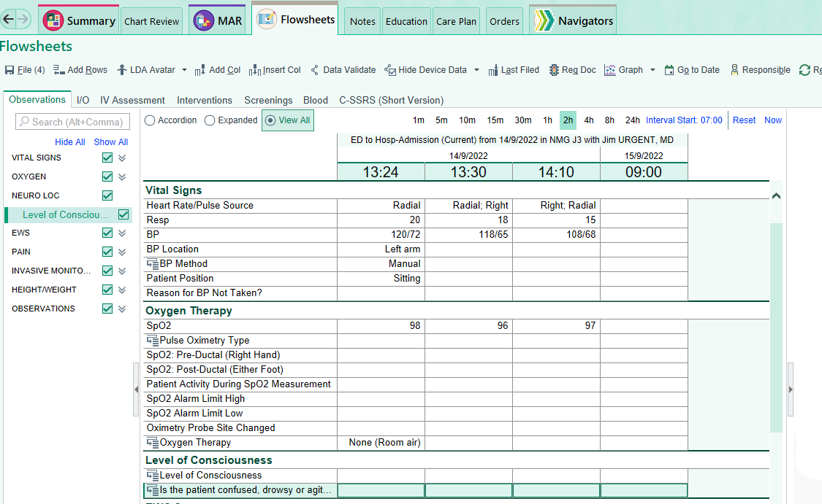
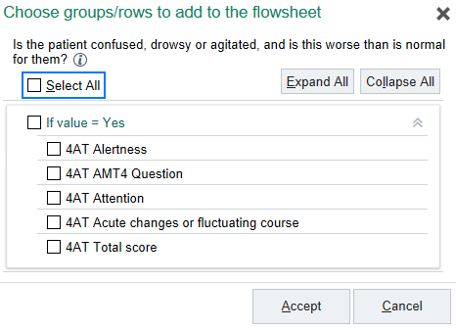

Slide 38
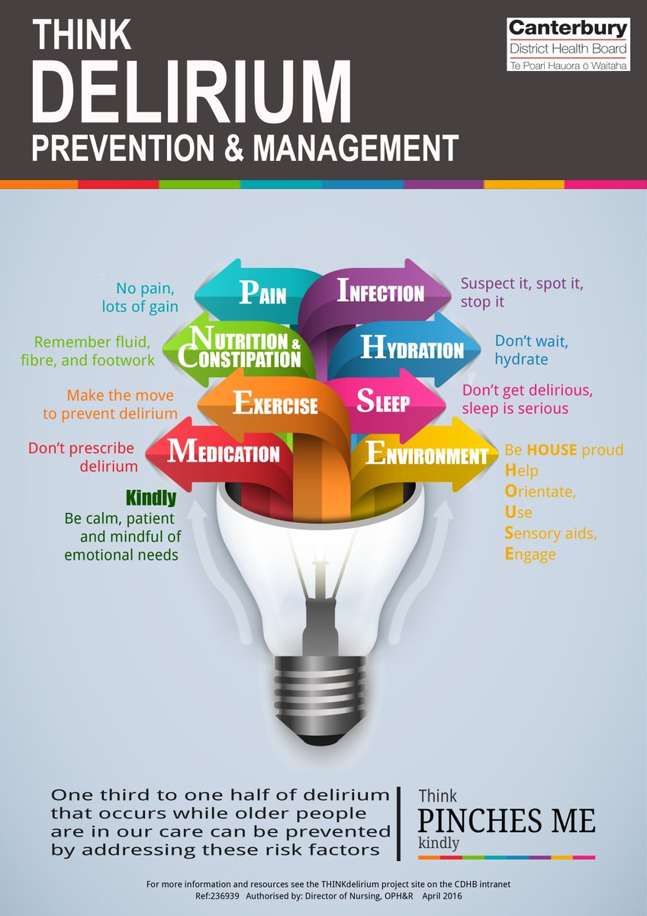

Slide 40
Contact Details
Samantha Turner
Dementia Specialist Nurse
Wythenshawe Trafford Withington and Altrincham (WTWA)
Email: samantha.turner@mft.nhs.uk
Telephone: 0161 291 5927

Slide 41




NEWS2 and 4AT
Professor Emma Vardy
Consultant Geriatrician and MAHSC Chair
Clinical frailty lead NCA

Slide 42
NEWS2
Aggregate early warning scoring system to identify acutely unwell patients
Calculated from routinely collected physiological measurements
Developed in 2012 by the Royal College of Physicians
Updated to include new confusion in 2017 National Early Warning Score (NEWS) 2 | RCP London

Slide 43
Aim
To assess the sensitivity of the NEWS2 for non-alert states for a 4AT 4AT (dementia-united.org.uk) score of 4 or above, indicating probable delirium, as a primary outcome
Vardy et al, In submission

Slide 44
Methods
All non-elective admissions aged 65 years and over to Salford Royal hospital between 1st March 2020 and 30th March 2022
At least one 4AT was completed within 24 hours of first attendance
AND at least one NEWS2 assessment occurred within 4 hours either side of this delirium screen
All analyses were conducted using R
Vardy et al, In submission

Slide 45
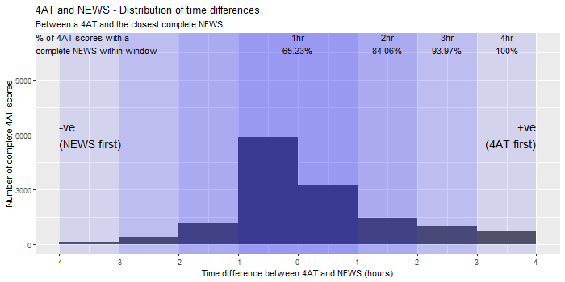
Vardy et al, In submission

Slide 46
Results
13,908 consecutive admissions
2,802 (20%) admissions with a 4AT≥4 consistent with probable delirium
594 (4.3%) admissions had a non-alert recorded on NEWS2
Sensitivity of a NEWS2 non-alert assessment for a 4AT≥4 was 17.8% (95% confidence interval [CI] 16.4%–19.2%), with a specificity of 99.1% (95% CI 98.9%–99.3%)
The alertness question on the 4AT identified 980 (7%) of admissions with ‘clearly abnormal’ arousal and 825 (6%) with ‘mild sleepiness’. Of the patients classed as ‘clearly abnormal’ arousal, 70.8% were assessed on NEWS2 as alert and of patients classed as ‘mild sleepiness’, 88.5% were assessed as alert.
Vardy et al, In submission

Slide 47
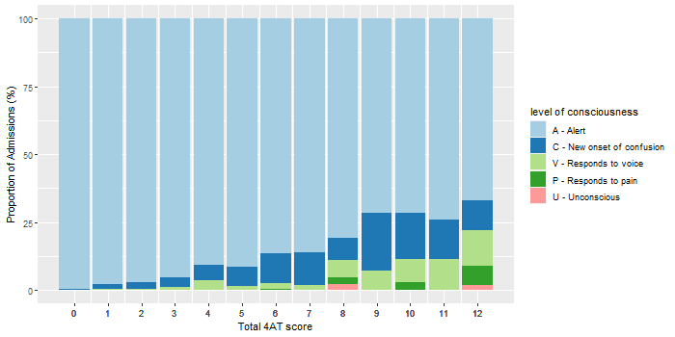
Performance of NEWS2
Vardy et al, In submission

Slide 48
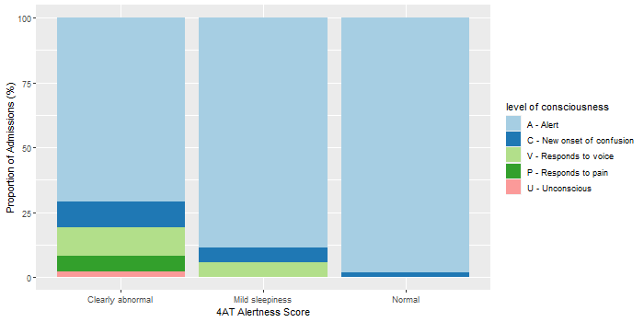
Vardy et al, In submission

Slide 49
Conclusion
NEWS2 has low sensitivity but high specificity for probable delirium based on 4AT scoring
Of those assessed as having clearly abnormal arousal on 4AT more than three quarters of these were assessed as being alert on the NEWS2
This single centre study shows that NEWS2 alone is not reliable for delirium detection
Vardy et al, In submission

Slide 50
Recommendations
Consider carefully presentation of consciousness sub-sections
Assessment of older person and those at risk of delirium using NEWS2 in conjunction 4AT
For older people ‘triple assessment’ Clinical Frailty Score/4AT/NEWS2

Slide 51
Acknowledgements
Atul Anand
Michael Cheng
Schan Santhirasekaran
Alasdair MacLullich

Slide 52
Thank you
emma.vardy@nca.nhs.uk
@emmavardy2

Slide 53
Pre-operative planning for risk of delirium- Tameside & Glossop ICFT
Why pre op?
Focus on prevention
The ONLY time when preparation for admission is an option
Other agendas (this is me, playlist for life)
Opportunity for meaningful engagement
Opportunity to enhance patient experience
Person Centred approach to care
Potential reduction in length of stay
Potential reduction in adverse incidents

Slide 54
Plan
Live list of pre op patients
Admiral Nursing team will call every person with dementia
3 month pilot
Digital Champions
Dementia Champions
Delirium Champions support
Volunteers
GM resources
Local ‘This me’ document

Slide 55
The conversation
Introduction
Purpose of the call
Previous surgery experiences
Provide a snapshot on delirium- do they recognise any of the symptoms
What they can do to prevent it
The purpose of ‘This is me’ This is me | Alzheimer's Society (alzheimers.org.uk)
Benefits of playlist for life (if appropriate) Resources – Playlist for Life
Permission to send ‘this is me’, GM delirium short leaflet
Follow up by AN after surgery

Slide 56
Pre-operative planning for risk of delirium
Kellie Smart
Lead Admiral Nurse
Tameside and Glossop ICFT
Email: kellie.smart@tgh.nhs.uk

Slide 57
Evaluation and thank you
What 3 things have you taken away from the session today?
Add your feedback in to the chat
An evaluation form will follow – please complete it as we are keen to ensure these sessions are of value to you all as we will have a further webinar around World Delirium Awareness Day in March 2023
If you are interested in presenting at a future webinar
Email: gmhscp.dementiaunited@nhs.net
Please promote, share and use the resources
Toolkit, training, delirium public facing leaflet
We will send the link round to the recording today along with the slides and some delirium training resources, please make sure we have your email; by adding this in the chat before you leave or by emailing
Get in touch if you want to find out more about any of the topics discussed today, or the Greater Manchester Delirium resources

