Slide 1
Greater Manchester Best Practice Delirium Event to mark World Delirium Awareness Day
Wednesday 12 March 2025
Friends’ Meeting House – The Main Hall

Slide 2
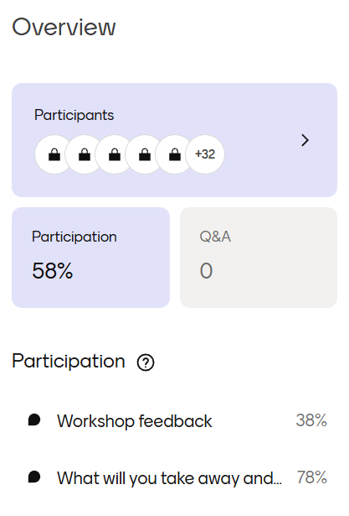
Mentimeter data

Slide 3
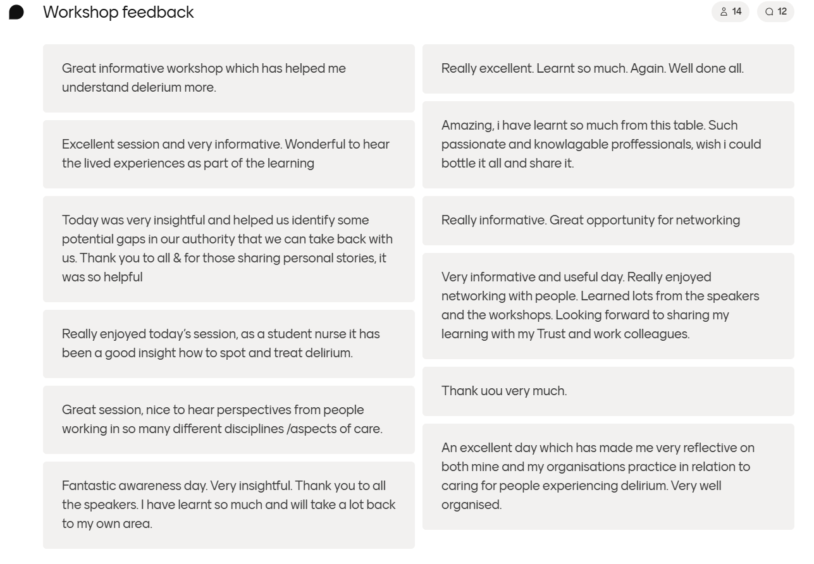
Responses

Slide 4
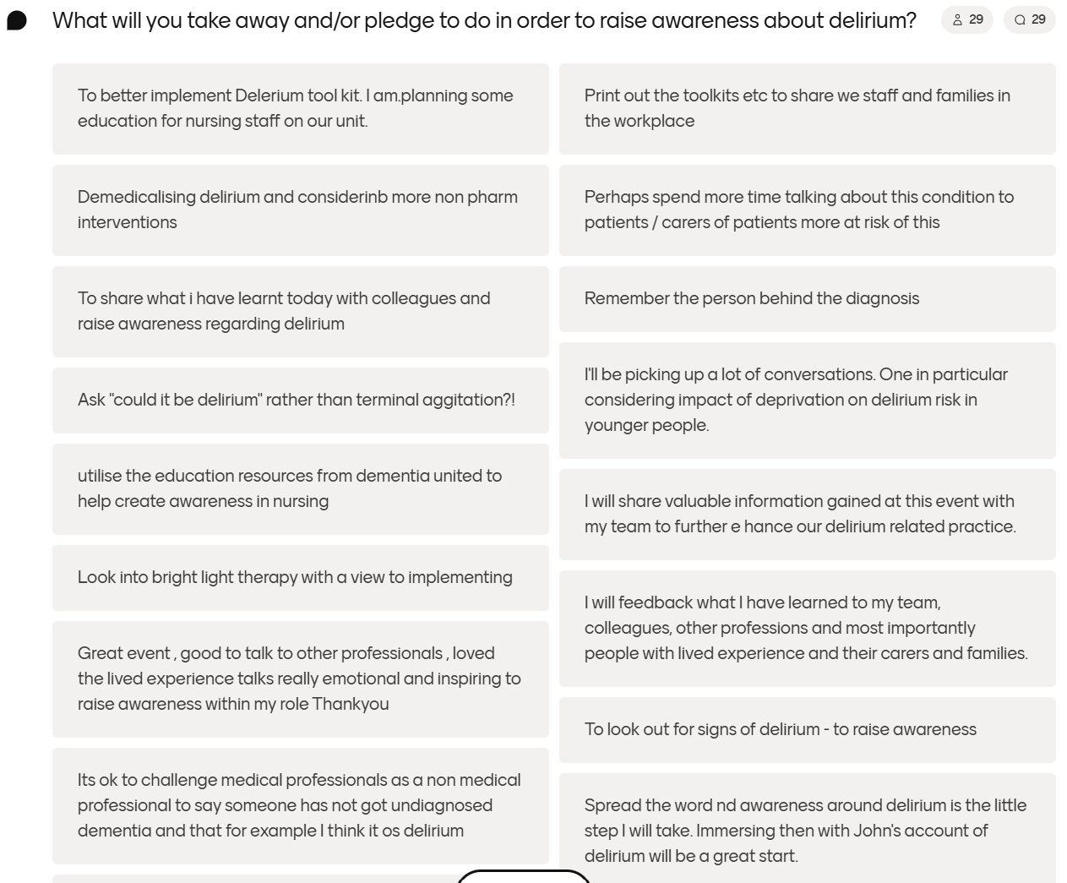
Pledges

Slide 5
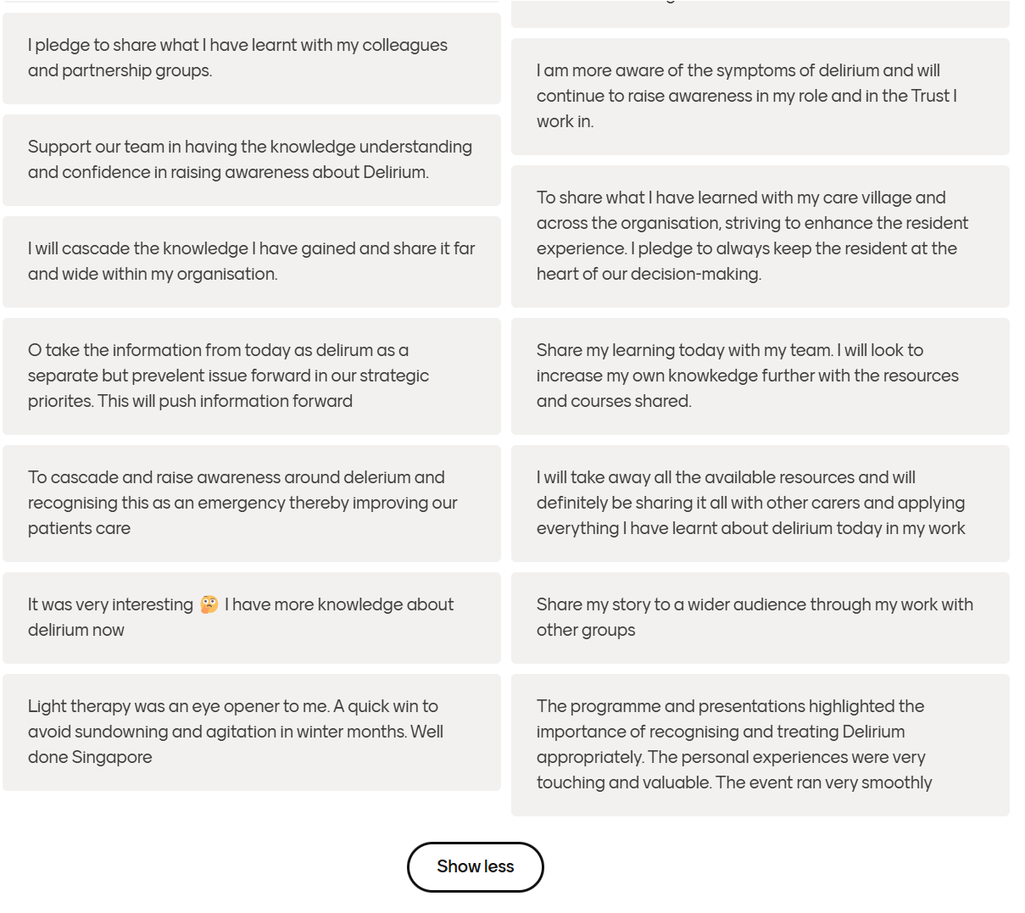
Pledges continued

